Slide 1
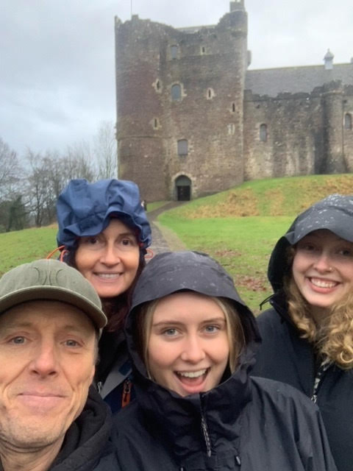
Send off for Michael Pitt
After what could only be described as a stellar career Michael has decided to hang up the keyboard and file away the terabytes.
We have all born witness to the technological advancements that have taken Fire and Rescue NSW into a new age.
Michael has been the driving force behind the majority of those changes, always keeping the front line firies foremost in his mind.
Come and help us celebrate his fantastic legacy.
Where: The York Street Bowlo
When: Thursday 28th March 2024.
Cost: $50 which includes finger food and a gift.
Payment details: Firefighters Mutual Bank
Account No: 101-082-018 BSB 802825
Account Name: Garry Warren
Please include your name and any dietary requirements.

